Slide 1



Churn Chasers
HomeExchange
Let’s go through our analysis project!

Slide 2

Home Exchange Platform
HomeExchange is a French platform was first found in 1992 in Paris, France
HomeExchange is the 1# global community for house swapping
HomeExchange aims to reduce mass tourism while also be a cost-effective alternative to traditional accommodation options

Slide 3
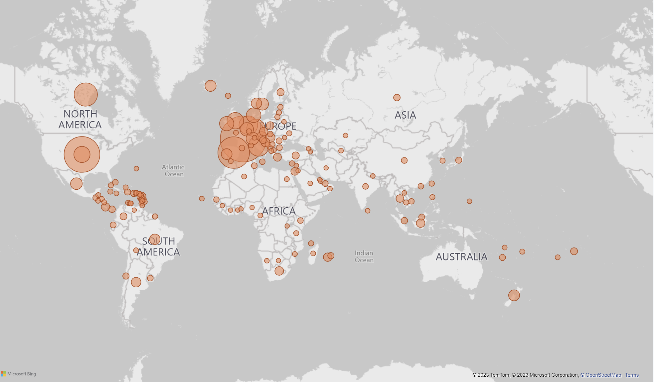
7
Conversations per minute
27K
New subscribers
Most users come from Europe
HomeExchange Overview
70.73K
Subscribers
3%
Confirmed exchanges
154
Countries

Slide 4


Exchange Types
The Classic Exchange
Two families exchange each others' homes, whether simultaneously or on different dates
Exchange with GuestPoints
If you are the guest and the host does not wish to stay in your house you can offer them guest points so they can use it to stay in another member house
Notes:
For the non_reciprocal exchange type the users preference are almost the same. But in the reciprocal exchange type the users prefer Home than apartment.

Slide 5
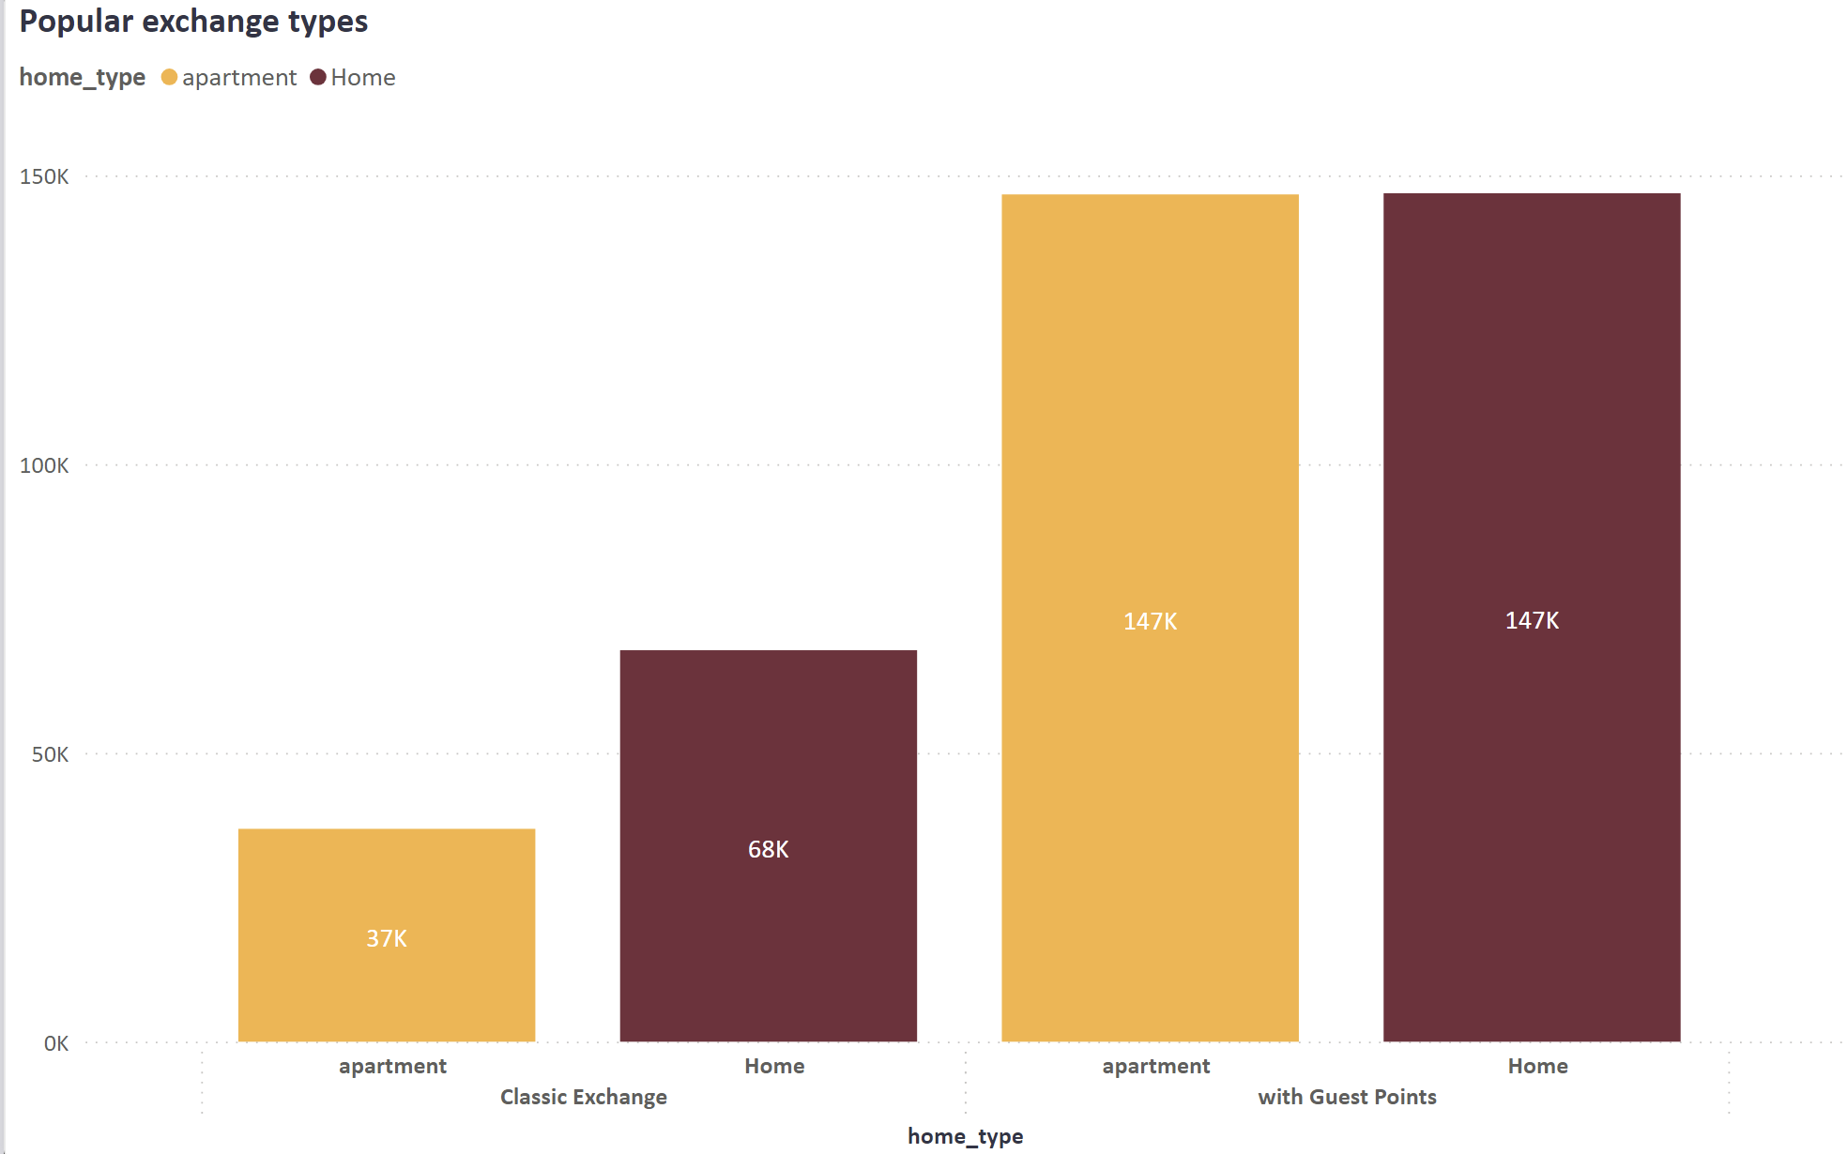
Overview: User Preferences
Most of the exchanges are guest points exchanges
number of exchanges
Notes:
For the non_reciprocal exchange type the users preference are almost the same. But in the reciprocal exchange type the users prefer Home than apartment.

Slide 6
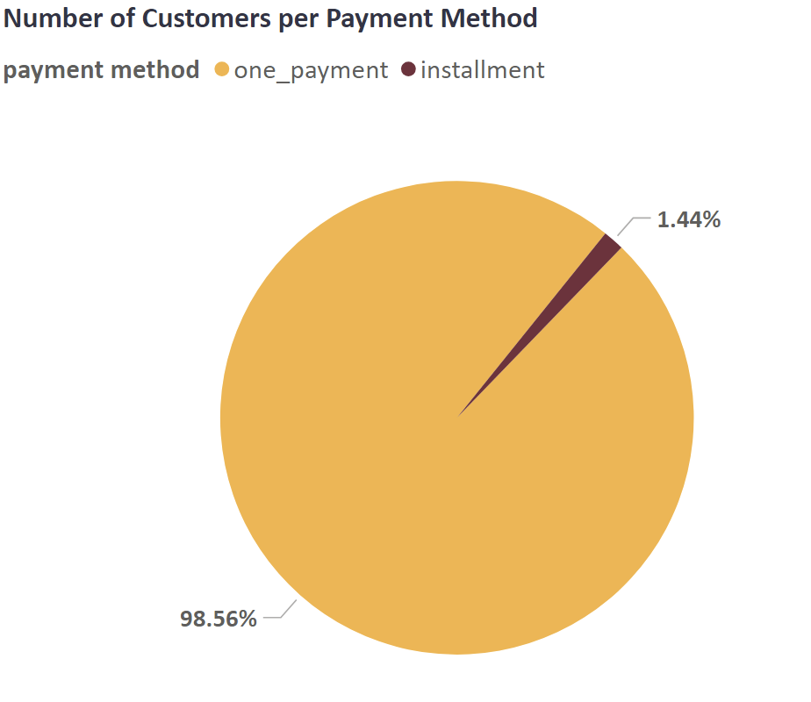
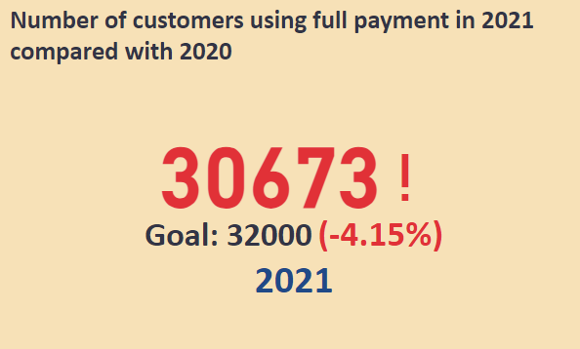
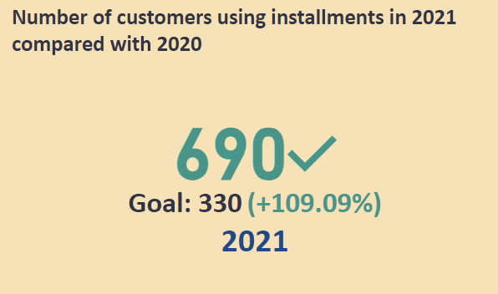
Overview: Users conversion
More users are interested in installments in 2021 compared to 2020

Slide 7
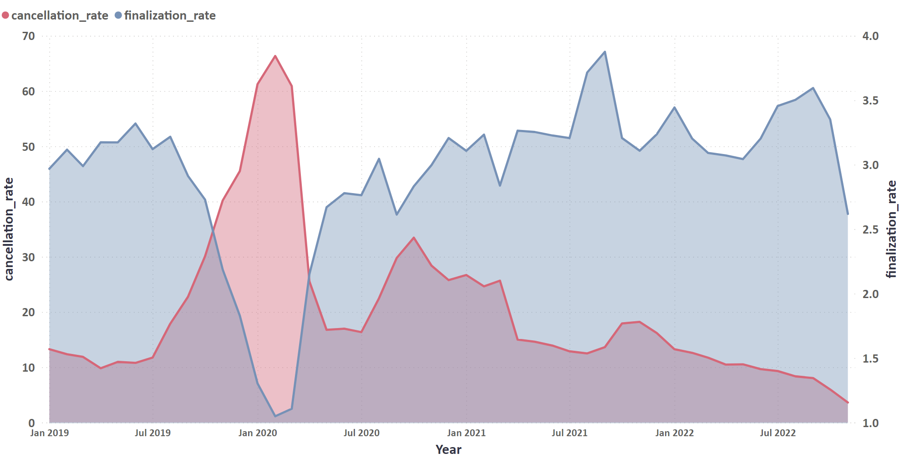
Overview: Performance Metrics over Time
A drop in finalization rate and a spike in cancellation rate due to covid-19
Notes:
The cancellation rate have a drop peak at 2020 due to pandemic lock down. But the platform start to recover from it and the finalized exchange become more than the canceled one

Slide 8
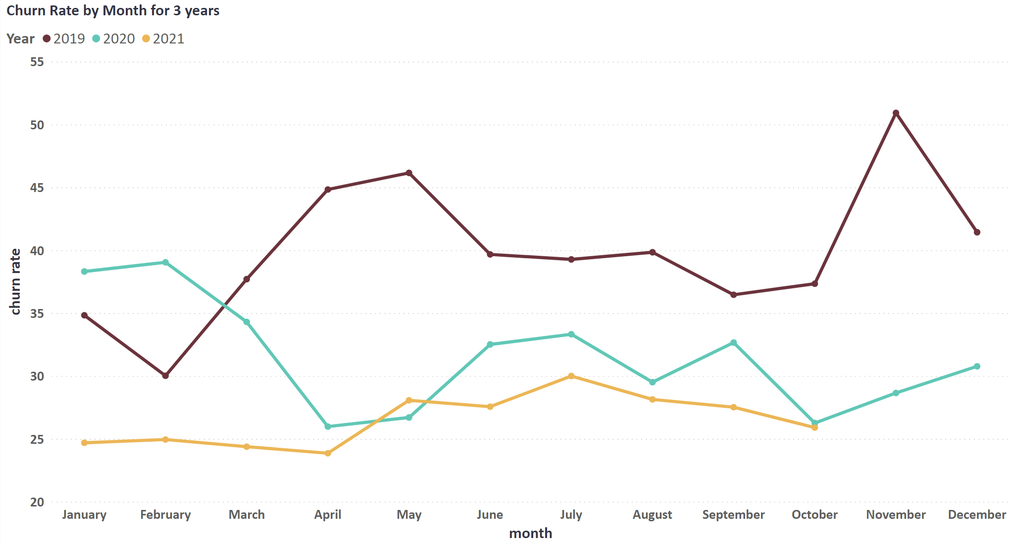
Overview: Churn Rate
Churn: users who do not wish to subscribe for another year
The churn rate is improving more for each year

Slide 9
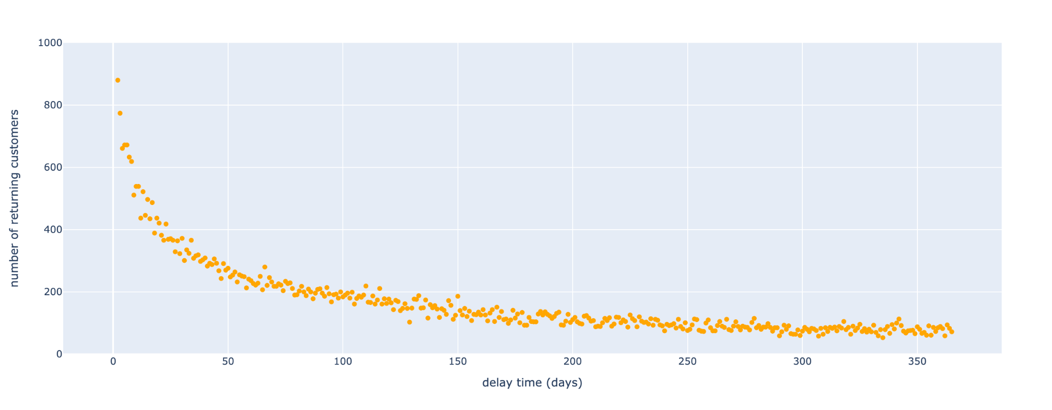
Churn Analysis: 1st Hypothesis
Delayed time between user subscription and first exchange negatively impacts customer retention
As the time delay increases less and less users re-subscribe

Slide 10
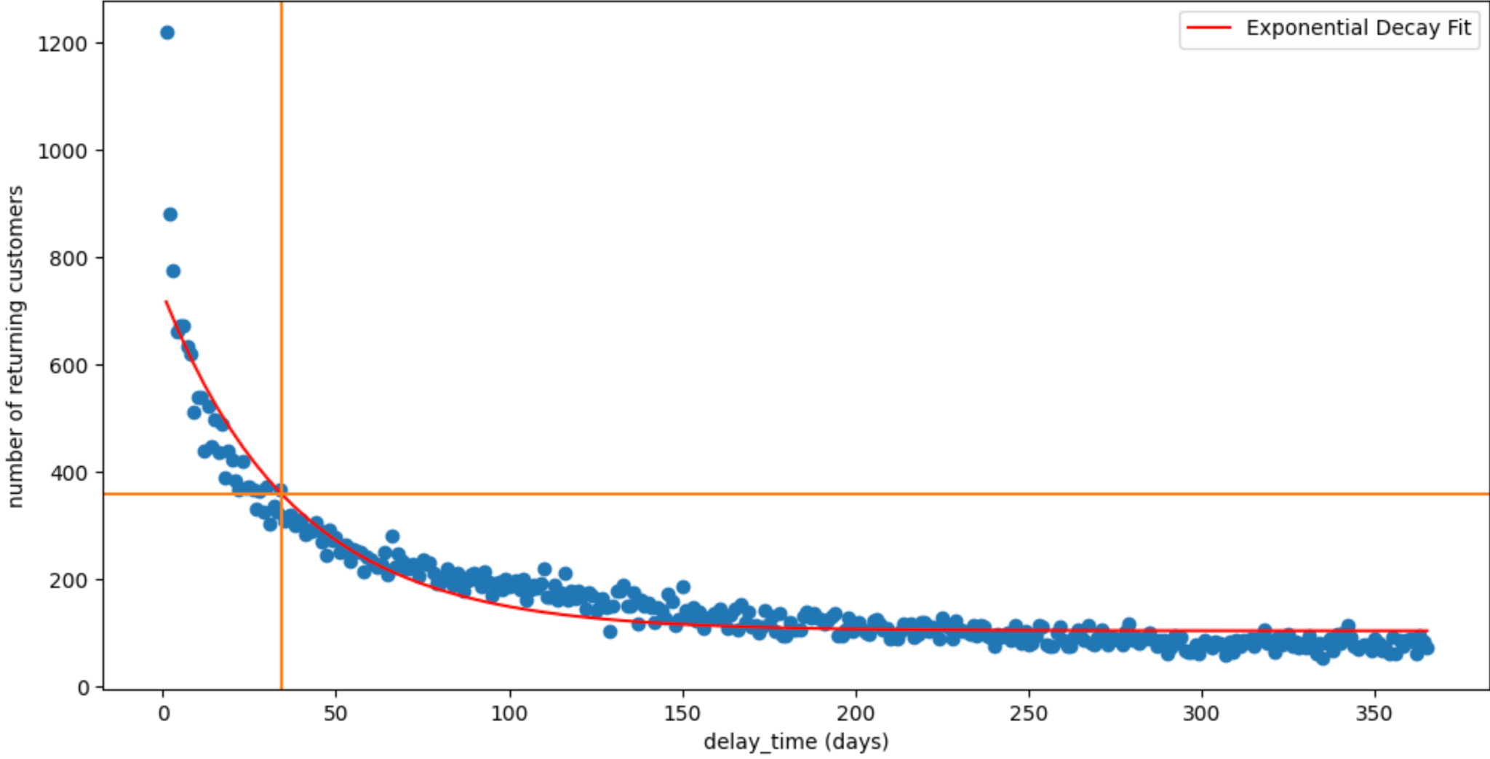
Churn Analysis: 1st Hypothesis
We performed statistical calculations and found a Threshold = 34 days
What we recommend?
Extra guest points to users securing their first exchange within 30 days
Weekly emails reminders for users to update their accommodation availability schedule
Notes:
The number of returning customers is less while the delay time become long.

Slide 11
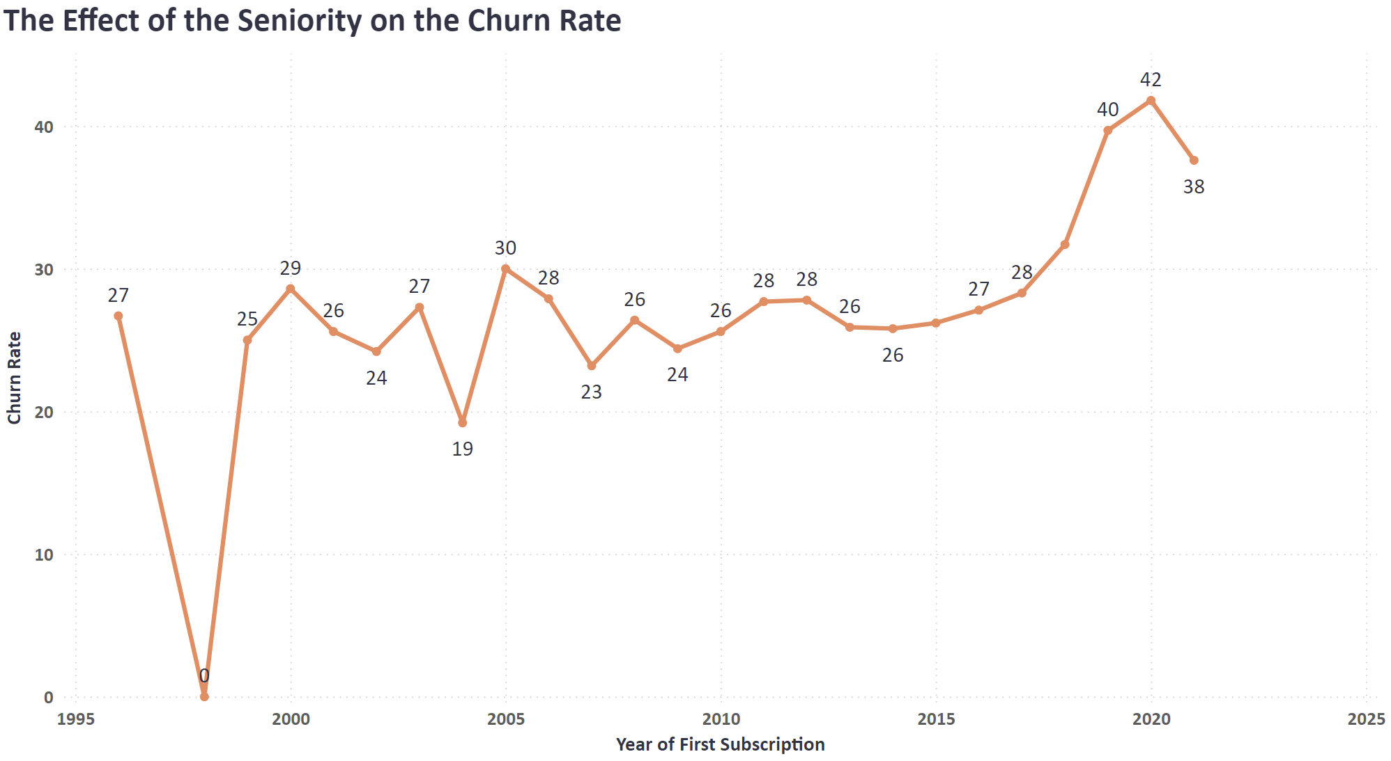
Churn Analysis: 2nd Hypothesis
New registered subscribers churn more
Churn rate increases from users who subscribe recently
What we recommend?
Continue offering special promotions to motivate new subscribers. (promotions started only in 2021)
Notes:
The churn rate is more for new users.

Slide 12
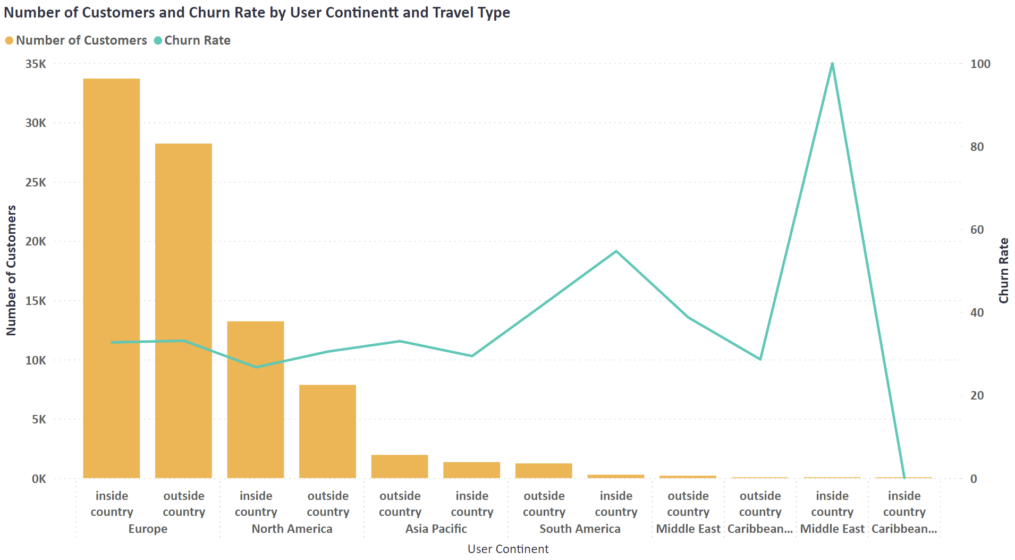
Churn Analysis: 3rd Hypothesis
Different travel types affect the churn rate based on user continent
Notes:
In general, if the user will exchange inside or out side her/his country that will not affect the churn rate. We can see that more users are in Europe and North America, while the market is growing in Asia Pacific. For North America, the users whom exchange outside the country will churn more than whom exchange inside. While in Asia Pacific, the users whom exchange inside the country will churn more than whom exchange outside. However, other countries have less users to produce accurate analysis.

Slide 13
Churn Analysis: 3rd Hypothesis
What we recommend?
Europe and North America:
Addressing issues specific to these regions that influence churn rate
Asia Pacific:
Personalised features.
Promotions for specific holidays.
Customer support in local languages
Other Regions:
Increase customer base
Partnering with local entities

Slide 14
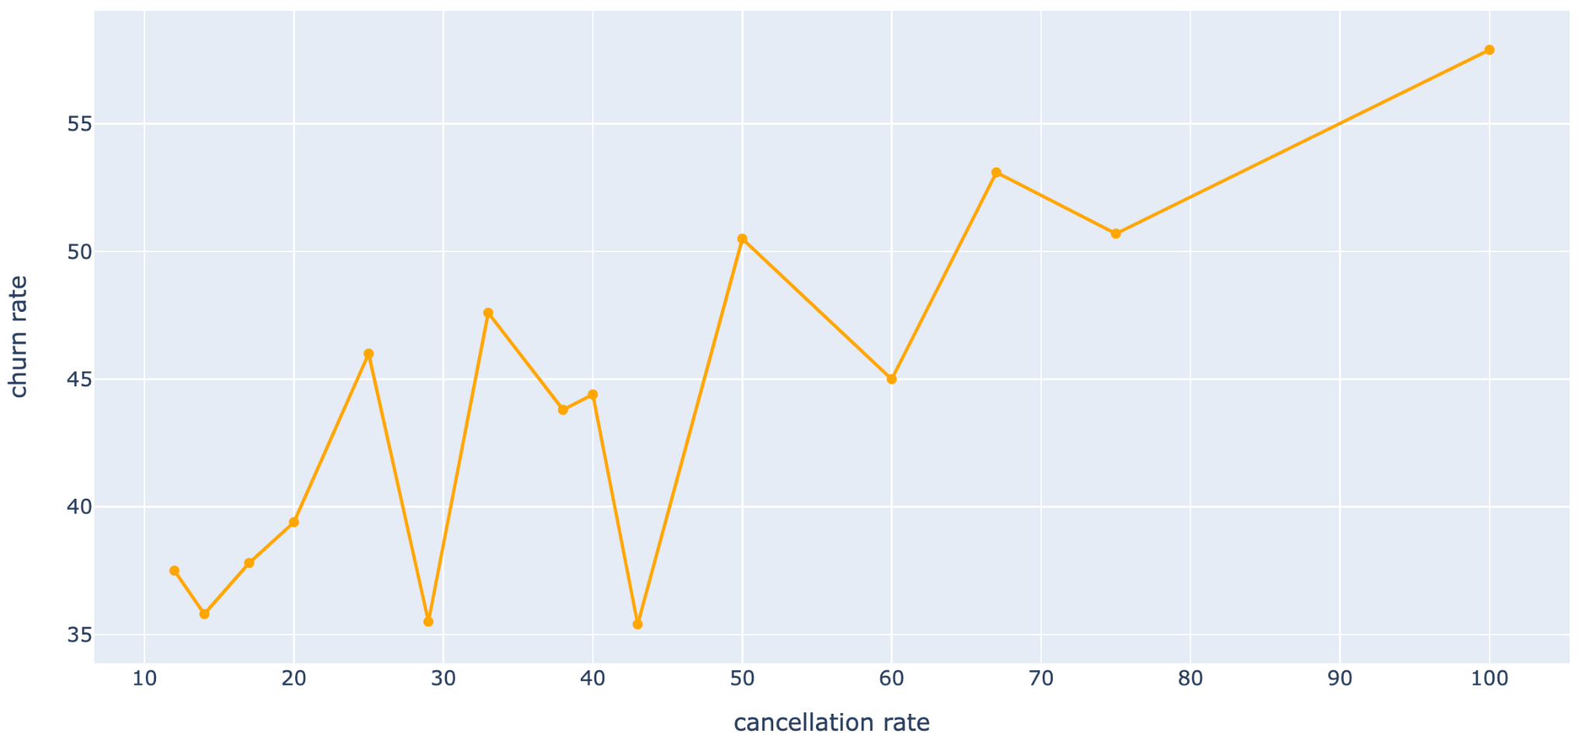
Churn Analysis: 4th Hypothesis
Customers who experienced cancellation tend to churn more.
A positive correlation between cancellation rate and churn rate
Notes:
Users whom face more canceled exchanges, they will chun more.

Slide 15


Churn Analysis: 4th Hypothesis
What we recommend?
> 60%
Cancellation rate
Cancellation Form
Compensation Form
Our customer satisfaction team will evaluate the form with also previous cancellation surveys to decide the right compensation
Notes:
For each cancellation, both parties need to complete a cancellation survey to identify the reasons of cancellation (we will encourage them by giving 15 guest points)
If the user experience cancellation more than 60%, they will have to fill a forum for compensation
Our customer satisfaction team will assess the forum with previous cancellation surveys to decide the right compensation

Slide 16
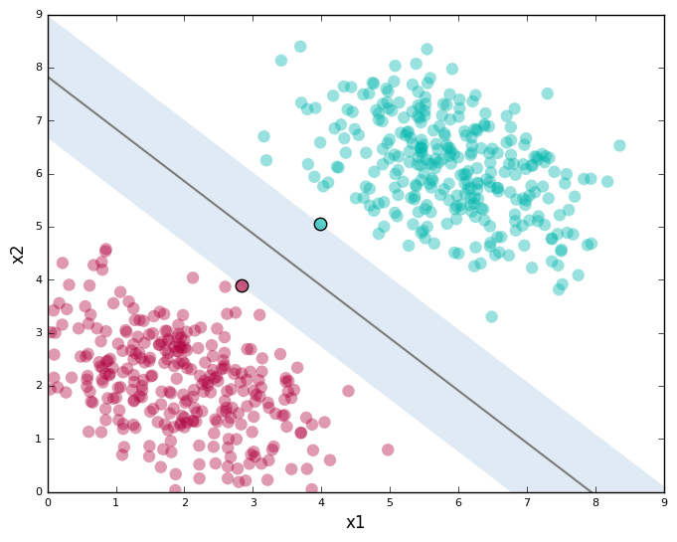
Churn Analysis: Predicting Churn
How can predicting churn have an impact on the business?
We have a classification model to predict churn with accuracy of 75%
This gives the company the ability to act according for those at risk of leaving by sending personalised emails, targeted retention campaigns for this segment of users
Returning
Leaving
New user?

Slide 17

Thank you for your attention !

Slide 18
